Slide 1
ELECTRICITY BILLING SYSTEM

Slide 2
PRESENTERS
B. KAVYA MANI GAYATHRI – 2010030234
B. SRAVANI - 2010030544

Slide 3
INDEX
INTRODUCTION
PROBLEM STATEMENT
LITERATURE SURVEY
GITHUB SETUP
WORK ALLOCATION
TOOLS REQUIRED
CONCLUSION

Slide 4
INTRODUCTION
The Electricity bill management system project in java is a web application that is developed to automate the billing system.
Modules in electricity bill management : Mainly there are three main modules of the application that describe the role of all the actors of the application.
Login registration : Admin(Electricity board user), and User(Customer) can log in and register in the application.
Billing :Admin can add details about the consumer of the details according to the consumed electricity units consumed by the consumer. Users can view the bill and check the due date all the details like start date, end date total consume electricity units ETC and process the payment. And Also the user can check the history of transactions.
Payment : Users can pay bills online so it will save time for admin as well as the user.
In this project, we are using a dummy payment page it’s not a real payment gateway.

Slide 5
PROBLEM STATEMENT
To ensure that users receive their bills on time and the correct bill . User can pay the bills from the comfort of their home , payment process is not at all stressful.
This has a modern database system unlike the traditional way of storing and managing customer details that electricity companies follow.

Slide 6
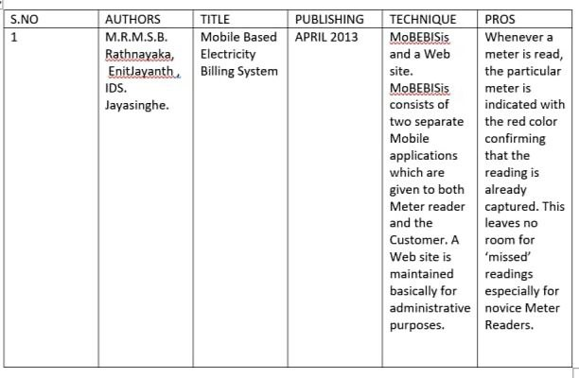
LITERATURE SURVEY

Slide 7
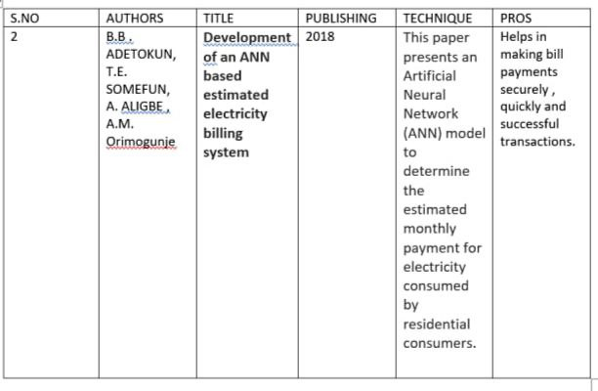

Slide 8
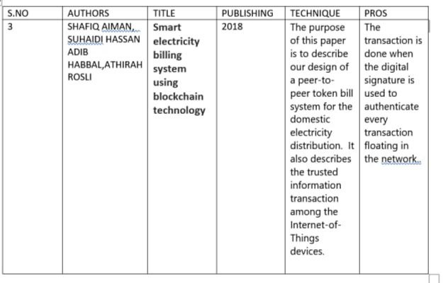

Slide 9
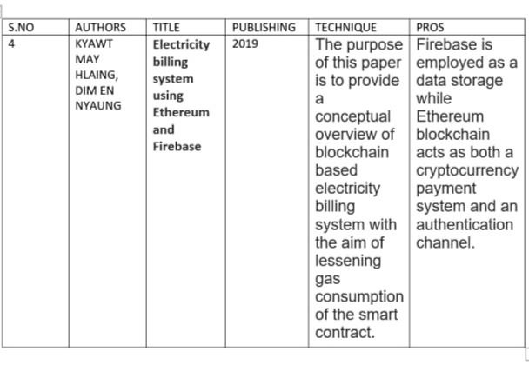

Slide 10
GITHUB SETUP

Slide 11
WORK ALLOCATION
B, Kavya Mani Gayathri – 2010030234
Frontend / web design
B. SRAVANI - 2010030544
Backend / Login

Slide 12
TOOLS & TECHNIQUES REQUIRED
DATABASE
CLIENT/SERVER TECHNOLOGY
HTML
MySQL
APACHE TOMCAT SERVER
ECLIPSE IDE

Slide 13
CONCLUSION
IN CONCLUSION , THIS PROJECT IS AIMED AT DEVELOPING AN ONLINE SYSTEM THAT WILL ENABLE USERS OF ELECTRICITY PROVIDED BY THIS COMPANY TO CHECK THEIR ELECTRICITY BILLS AND MAKE THEIR PAYMENT ONLINE.

Slide 14


